Slide 1
Welcome to St. Agnes Religious Education

Slide 2
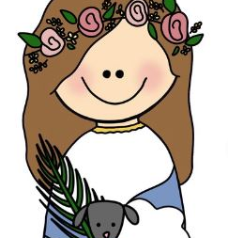
RE 2024-2025
Family Faith Formation on 1st RE session of each month
To build up the domestic Church
To build faith community among RE families
Formal instruction begins next week
Proceed directly to the classroom before 6:15PM
Pick up in classroom for Grades 1-2
Avoid parking in the lot fronting the school
Flipped classroom model
Word of Life online access
Confirmation students & parents in Year 1 & 2 will meet in the gym next week
Updated calendar for key events
Reminder: No more than 4 absences in a year (excused or unexcused)
Meet the catechists

Slide 3
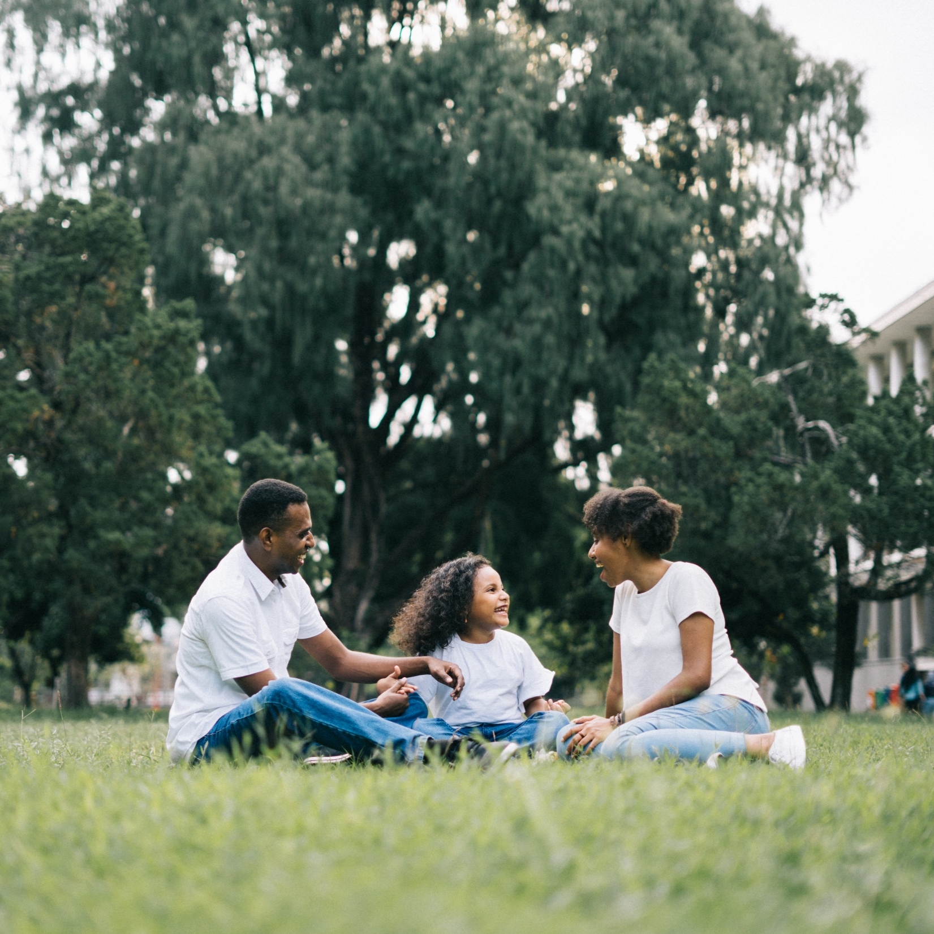
^{Family faith formation}
Lesson 1 -
the domestic church

Slide 4
Family Conversation
Who in your family teaches or has taught you the most about God?

Slide 5
^{The Domestic Church &} Parents as the Primary Educators of the Faith
REFERENCES
Catechism of the Catholic Church
CREED
LITURGY
LIFE
PRAYER
^{CCC: 2223}
^{Prv 22:6}
^{Eph 6:1-4}
^{nos.}
⁵³¹⁻⁵³⁴
^{nos.}
¹⁶⁵⁵⁻¹⁶⁵⁸
^{nos.}
²²¹⁴⁻²²³³
^{nos.}
²⁶⁸⁵
&
²⁶⁸⁸
Notes:
CATECHISM OF THE CATHOLIC CHURCH #2223
Parents have the first responsibility for the education of their children. They bear witness to this responsibility first by creating a home where tenderness, forgiveness, respect, fidelity, and disinterested service are the rule. The home is well suited for education in the virtues. This requires an apprenticeship in self-denial, sound judgment, and self-mastery – the preconditions of all true freedom. Parents should teach their children to subordinate the “material and instinctual dimensions to interior and spiritual ones.” Parents have a grave responsibility to give good example to their children. By knowing how to acknowledge their own failings to their children, parents will be better able to guide and correct them: He who loves his son will not spare the rod. .. He who disciplines his son will profit by him. (Prov 13:24)
PROVERBS 22: 6 – “Train up a child in the way he should go and when he is old, he will not depart from it.”
EPHESIANS 6:1-4 – “Children, obey your parents in the Lord, for this is right. ’Honor your father and mother’—which is the first commandment with a promise— ’so that it may go well with you and that you may enjoy long life on the earth.’ Fathers, do not provoke your children; instead, bring them up in the training and instruction of the Lord.”

Slide 6
Monsignor Saunders
The Domestic Church and parents as primary educators.

Slide 7
Family to Family Connections
Gather with 2-3 families next to you.
Share the challenges you face in living as a domestic Church and ideas on how to strengthen your family’s faith.

Slide 8
Mission: Family Altar

Slide 9
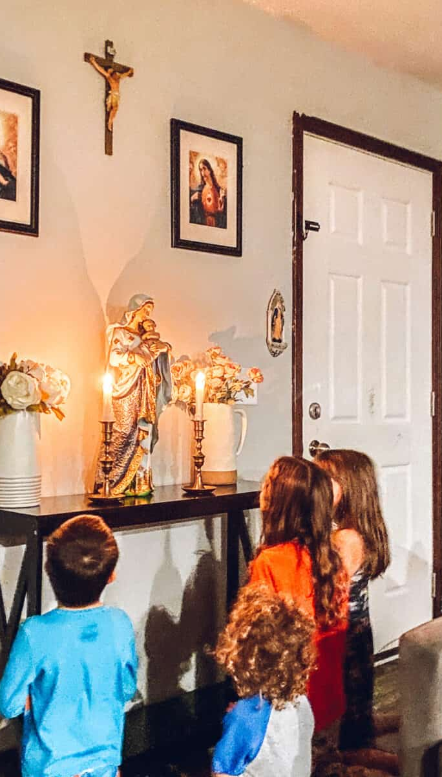
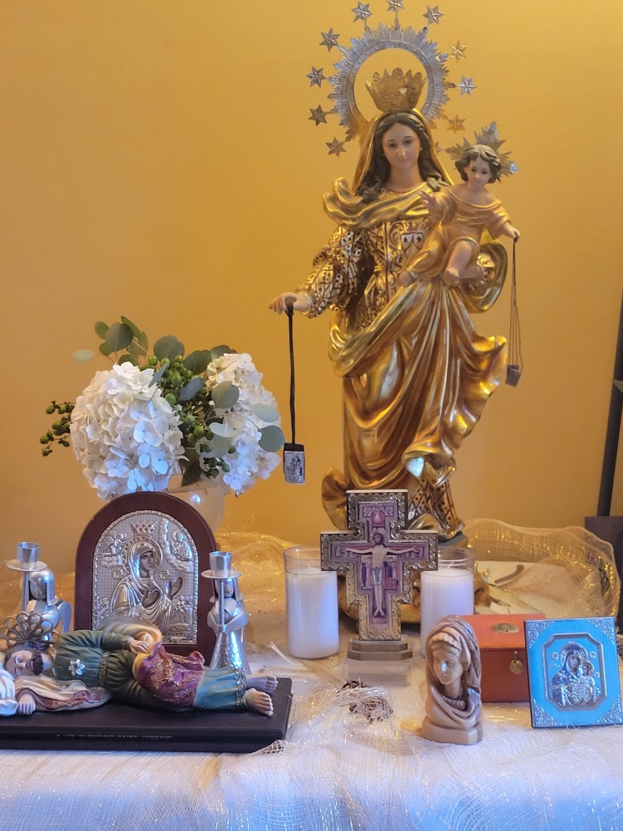
Family Altar

Slide 10
^{Closing Prayer}
Lord Jesus, may you bless each of the families gathered together today. Help us to
continually grow closer to you. This we pray in Your Holy Name. Amen.
^{Our Father (+)}

